Slide 1

Community connect Affiliated Hospital: Homeopathic Research Foundation, Lucknow
Presented by: Devyansh Sharma
Register Number: RA22110270100105

Slide 2

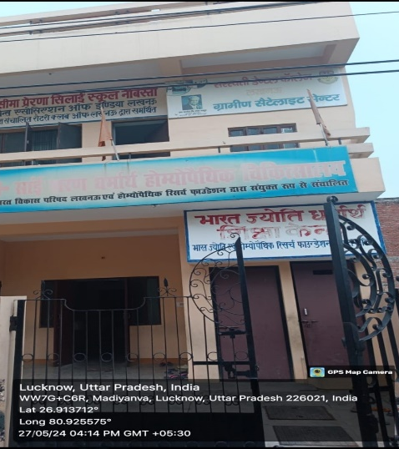

INTRODUCION TO THE ORGANIZATION
Overview:
Bharat Jyoti Siksha Kendra is an exemplary NGO dedicated to providing quality education to students from poor backgrounds. Established with a vision to illuminate young minds and foster holistic development, the NGO emphasizes academic excellence, moral values, and extracurricular activities. It boasts a team of experienced educators who are committed to nurturing students' intellectual curiosity and critical thinking skill.
Established by:
The Program was pioneered by Dr. Girish Gupta a Renowned Homoeopathic Doctor who founded the Homoeopathic Research Foundation in 2007 under which the Bharat Jyoti Siksha Kendra works.

Slide 3

OBJECTIVE
.
Objectives:
Equity and Inclusivity: Providing equal opportunities regardless of background.
Community Participation: Encouraging active involvement and accountability.
Quality Education: Focusing on excellence in both academics and values.
Sustainability: A child-centered approach focusing on long-term impact.

Slide 4
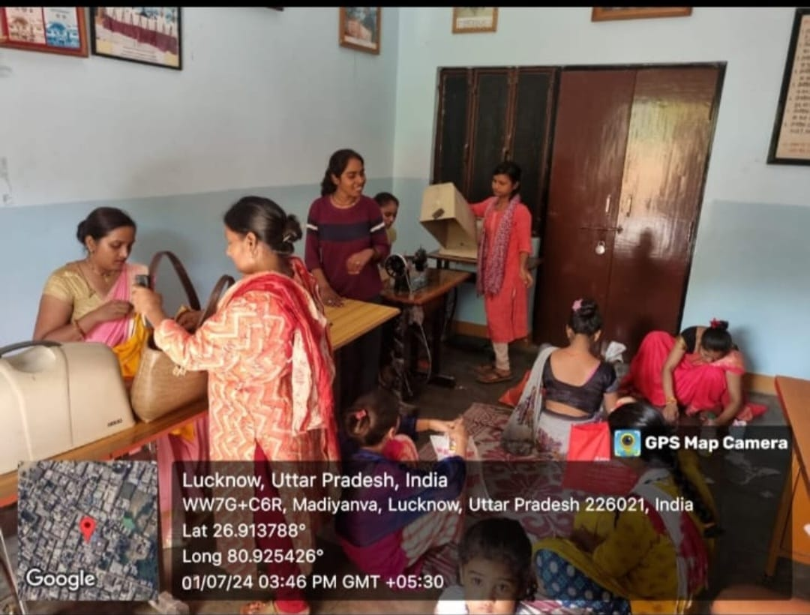

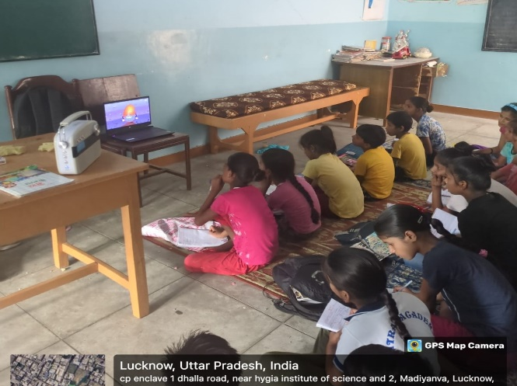
ROLE AS A VOLUNTEER
Teaching and Mentoring:
Conducted interactive sessions on subjects such as Science, Hindi, and English to enhance the students’ foundational knowledge.
Developed lesson plans tailored to the students' interests, focusing on engaging methods like storytelling, animations, and hands-on activities to make learning enjoyable.
Environmental and Health Awareness:
Organized sessions on environmental conservation, highlighting topics like the importance of trees, cleanliness, and sustainability.
Educated students on health-related topics, including the benefits of hygiene, the dangers of junk food, and the importance of staying hydrated.
Community Engagement and Empowerment:
Led a food distribution drive to support underprivileged families, instilling the value of social responsibility in students.
Volunteered in a tailoring workshop to empower women, promoting skill development and financial independence.

Slide 5
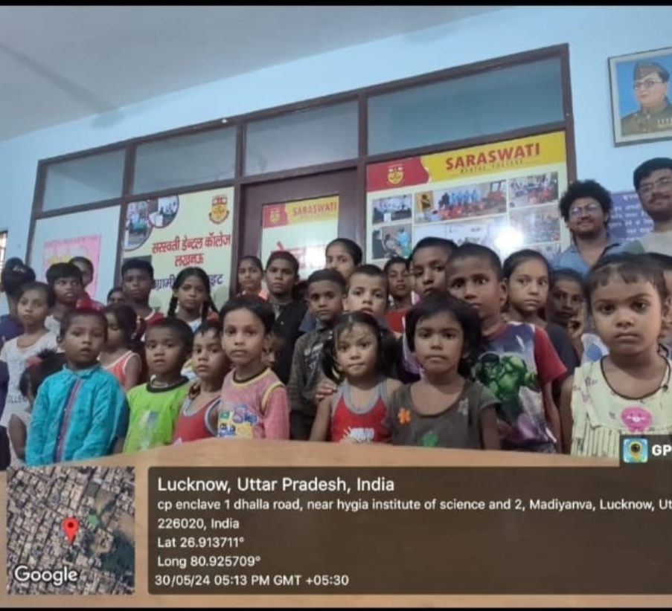
Day to day activities
Day 1: Orientation & IntroductionDay
Day 2: Solar System Education
Day 3: Environmental Awareness
Day 4: Understanding Natural Disasters
Day 5: Aquatic & Mammal Life
Day 6: Women Empowerment & Tailoring
Day 7: States of Matter
Day 8: Importance of Water
Day 9: Food Distribution for the Needy
Day 10: Hindi Language Basics
Day 11: Natural Resources
Day12: Sustainable Development
Day 13: English Language Basics
Day 14: Health Awareness
Day 15: Movie Screening

Slide 6
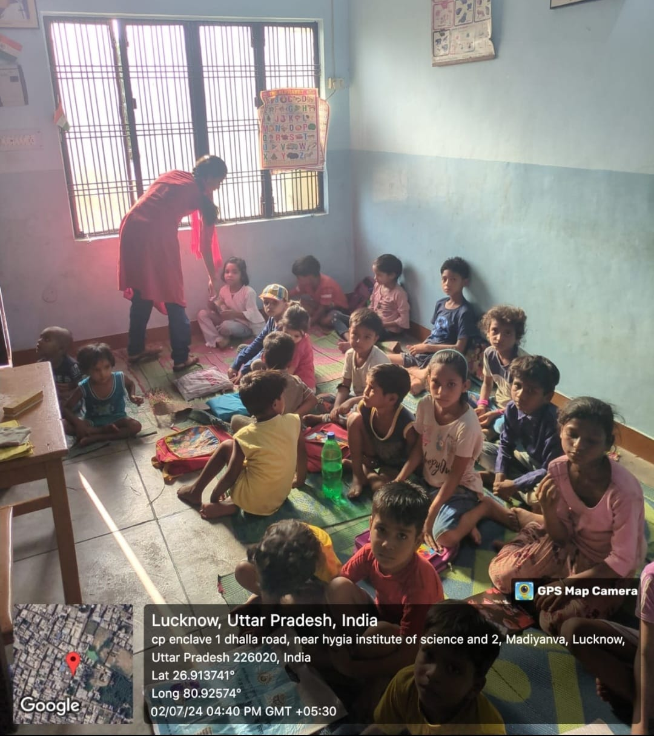
Personal development and growth
Through this 15-day volunteering experience, I gained valuable skills in teaching, communication, and leadership. Interacting with students improved my ability to adapt, engage diverse groups, and simplify complex topics. Witnessing the impact of education on young minds was deeply fulfilling, enhancing my empathy, patience, and dedication to community service. This journey not only expanded my knowledge but also inspired me to continue contributing to social causes.

Slide 7
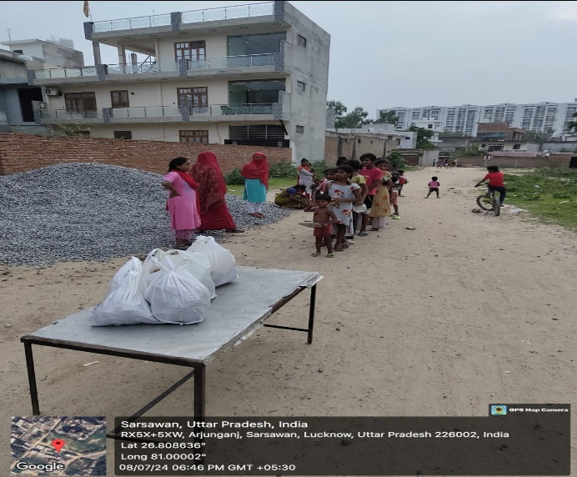
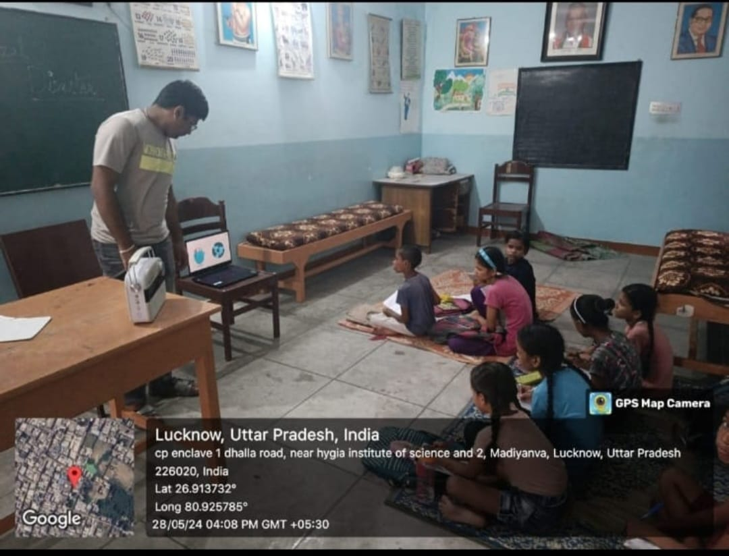
Tangible learning outcomes
Summary of Student’s Learning:
Delivered customized lessons in computer skills and academic subjects to students from underprivileged backgrounds.
Adapted teaching methods to address diverse learning needs and effectively manage classrooms.
Provided mentorship to encourage student engagement and academic development.
Enhanced communication, time management, and problem-solving skills through hands-on teaching experience.

Slide 8
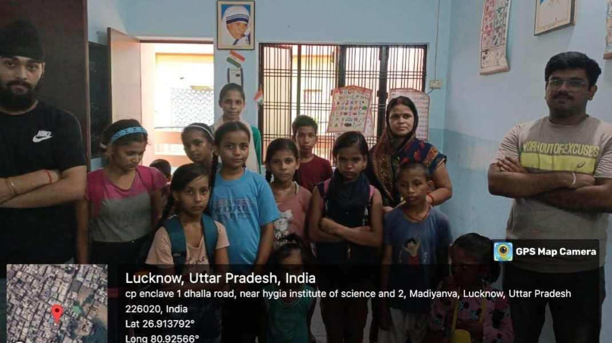
Conclusion and Takeaways
My experience at Bharat Jyoti Siksha Kendra was both fulfilling and eye-opening. Teaching computer skills and academic subjects to children from underprivileged backgrounds enriched my understanding of educational equity and the transformative impact of learning. I customized my teaching approach to meet the diverse needs of the students, creating an inclusive environment that encouraged growth and engagement.

Slide 9


Thank you

